Slide 1


Mohan Paramasivam
2025-10-24

Slide 2

Outline
Executive Summary
Introduction
Methodology
Results
Conclusion
Appendix
https://github.com/mohanpsivam/spacex-capstone

Slide 3
Executive Summary
Summary of Methodologies
Collected SpaceX Falcon 9 launch data using REST API, web scraping, and CSV datasets.
Performed data wrangling to clean, merge, and structure the data for analysis.
Conducted Exploratory Data Analysis (EDA) using SQL and visualization libraries.
Built interactive maps with Folium to explore spatial launch patterns.
Developed a Plotly Dash dashboard for dynamic data exploration.
Applied machine learning classification models to predict launch success based on payload, site, and booster parameters.
Summary of Results
Discovered that payload mass and launch site are strong indicators of mission success.
Launches from KSC LC-39A showed the highest success rate.
Reusable boosters significantly improved reliability and reduced cost.
Interactive dashboard and maps effectively visualized insights for decision-making.
Achieved a predictive model accuracy of around 83%, confirming consistent classification performance.

Slide 4
Introduction
Project Background and Context
SpaceX designs, manufactures, and launches advanced rockets and spacecraft.
The company’s long-term goal is to make reusable rocket technology reliable and cost-efficient.
This project analyzes historical SpaceX Falcon 9 launch data to understand the factors influencing launch outcomes.
The study uses real-world data collected from APIs, web sources, and CSV files to simulate a complete data science workflow — from collection to prediction.
Problems Want to Find Answers:
Which factors most strongly affect the success of a Falcon 9 launch?
Does payload mass or launch site influence mission success?
How do booster versions and flight reuse contribute to performance improvement?
Can we predict future launch outcomes using machine learning models?

Slide 5

Section 1

Slide 6
Methodology
Executive Summary
Data collection methodology:
Perform data wrangling
Perform exploratory data analysis (EDA) using visualization and SQL
Perform interactive visual analytics using Folium and Plotly Dash
Perform predictive analysis using classification models

Slide 7
Data Collection
Github Link
Retrieved launch data from SpaceX API (missions, dates, sites, payloads).
Used provided CSV datasets for historical launch information.
Performed web scraping to get extra launch site details.
Combined all sources into a central dataset for analysis.
Unified Dataset
Web Scraping
CSV Files
SpaceX API
Data Cleaning & Processing

Slide 8
Data Wrangling
Github Link
Loaded raw data from SpaceX API and CSV files into Pandas DataFrames.
Checked for missing values and data inconsistencies.
Cleaned column names, standardized formats (e.g., launch site, booster version).
Converted data types — especially date and numeric fields.
Removed duplicates and irrelevant columns.
Created new derived fields (e.g., success flag, payload mass range).
Saved the cleaned dataset for visualization and modeling.
Data Wrangling
Raw SpaceX API Data & CSVs
Load into Pandas DataFrame
Identify Missing / Invalid Data
Clean & Standardize Columns
Convert Data Types
Feature Engineering (Derived Columns)
Export Clean Dataset

Slide 9
EDA with Data Visualization
Github Link
Used Matplotlib and Seaborn to explore trends and patterns.
Plotted bar charts to compare the number of launches by site and booster version.
Created scatter plots to study the relationship between payload mass and launch success rate.
Drew pie charts to show the proportion of successful vs. failed launches.
Used box plots to visualize payload distribution and identify outliers.
Visualized correlation heatmap to understand relationships between numerical features.
These visualizations helped identify key factors influencing SpaceX launch outcomes.
Why These Charts
Bar charts: for categorical comparisons.
Scatter plots: to observe trends between continuous variables.
Pie charts: for quick success rate overview.
Heatmap: to highlight variable correlations at a glance.

Slide 10
EDA with SQL
Github Link
Summary of SQL Queries
Selected key columns from the launch dataset to focus on mission success, payload, and launch site.
Counted total launches per site to find the busiest launch locations.
Calculated success rates for each launch site using conditional aggregation.
Identified most frequently used booster versions and their success performance.
Computed average payload mass grouped by booster version and launch site.
Filtered records to display only successful launches for trend comparison.
Ordered and limited results to highlight top-performing boosters.
Joined tables (when required) to combine launch details with payload information.

Slide 11
Build an Interactive Map with Folium
Github Link
Summary of Map Objects
Markers: Plotted for each SpaceX launch site to pinpoint exact geographic locations.
Circle Markers: Added to represent proximity and landing zones visually.
Popups: Included for each marker to display site name, coordinates, and success rate.
Polylines: Drew lines between launch sites and landing points to illustrate trajectory paths.
Tile Layers: Used different map styles (OpenStreetMap, Stamen Terrain) for better visual clarity
Purpose of These Objects
To visualize spatial relationships between launch sites and landing outcomes.
To highlight reusable booster locations and success distribution geographically.
To make the EDA findings more interactive and intuitive for peer reviewers.

Slide 12
Build a Dashboard with Plotly Dash
Github
Summary of Plots and Interactions
Dropdown Menu: Added to select different launch sites dynamically.
Pie Chart: Displays the success vs. failure rates for the chosen launch site.
Scatter Plot: Shows the relationship between payload mass and launch success.
Range Slider: Allows users to filter payload mass interactively to see its effect on success rate.
Responsive Layout: Dashboard automatically updates when filters or site selections change.
🎯 Purpose of These Plots and Interactions
To enable interactive exploration of launch success patterns.
To compare launch sites visually and understand performance differences.
To identify payload ranges that yield the highest success probability.
To present findings in an engaging, data-driven format for better decision support.

Slide 13
Predictive Analysis (Classification)
Github
Summary of Model Development
Selected key features such as payload mass, launch site, booster version, and reuse flag.
Split the dataset into training and test sets to ensure unbiased evaluation.
Trained multiple classification models:
Logistic Regression
Support Vector Machine (SVM)
Decision Tree Classifier
K-Nearest Neighbors (KNN)
Used GridSearchCV for hyperparameter tuning to improve accuracy.
Evaluated performance using confusion matrix, accuracy score, and classification report.
Found that the SVM (RBF kernel) delivered the best performance (~83% accuracy).
Cleaned Dataset
Feature Selection & Encoding
Train-Test Split
Model Training (LR, SVM, DT, KNN)
Hyperparameter Tuning (GridSearchCV)
Model Evaluation & Comparison
Best Model Selected (SVM - RBF)

Slide 14
Results
Exploratory data analysis results
Interactive analytics demo in screenshots
Predictive analysis results

Slide 15

Section 2

Slide 16
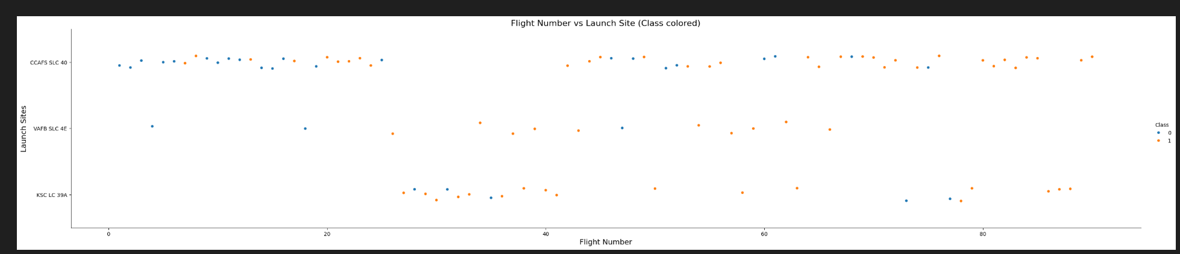
Flight Number vs. Launch Site
Scatter plot of Flight Number vs. Launch Site
Scatter plot shows each Falcon 9 flight number by launch site.
Successful launches are highlighted in green, failures in red.
This helps visualize trends in success rates across sites over time.”

Slide 17
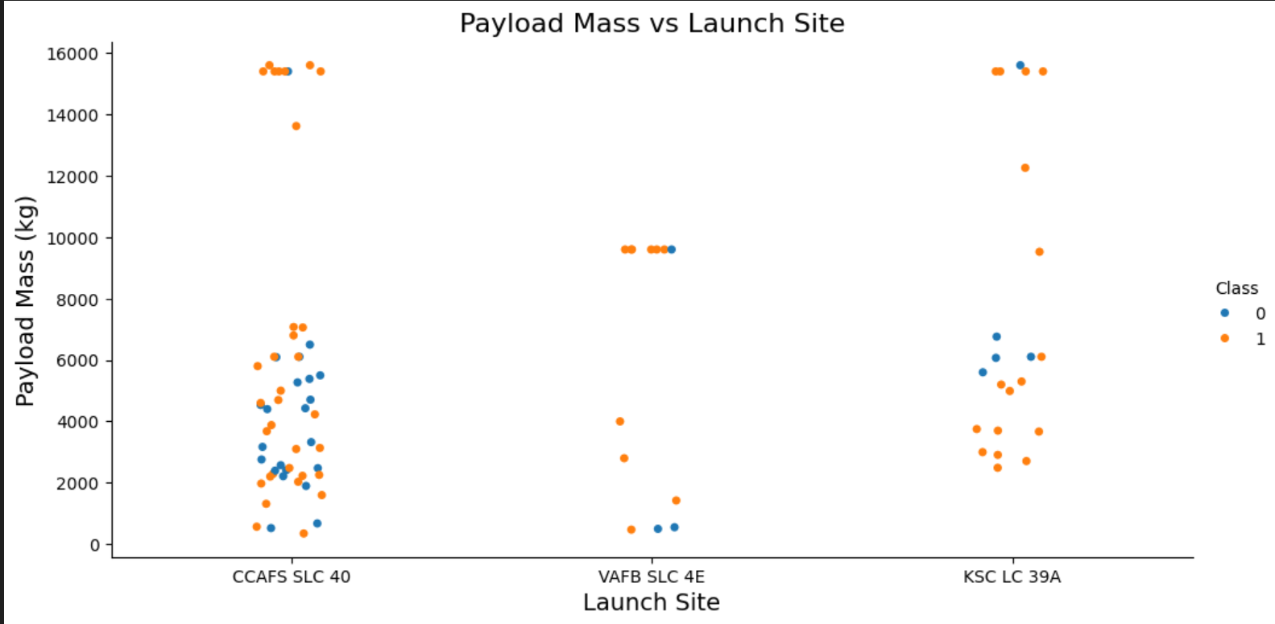
Payload vs. Launch Site
Relationship between Payload Mass and Launch Site
The scatter plot displays Payload Mass (kg) vs. Launch Site.
Blue points (Class 0): Launch failures
Orange points (Class 1): Successful launches
Most failures (blue) occur at heavier payloads or at specific launch sites.
Successful launches (orange) are concentrated in certain optimal payload ranges.
This visualization highlights which payloads and launch sites have historically higher success rates, guiding predictive analysis and operational decisions.

Slide 18
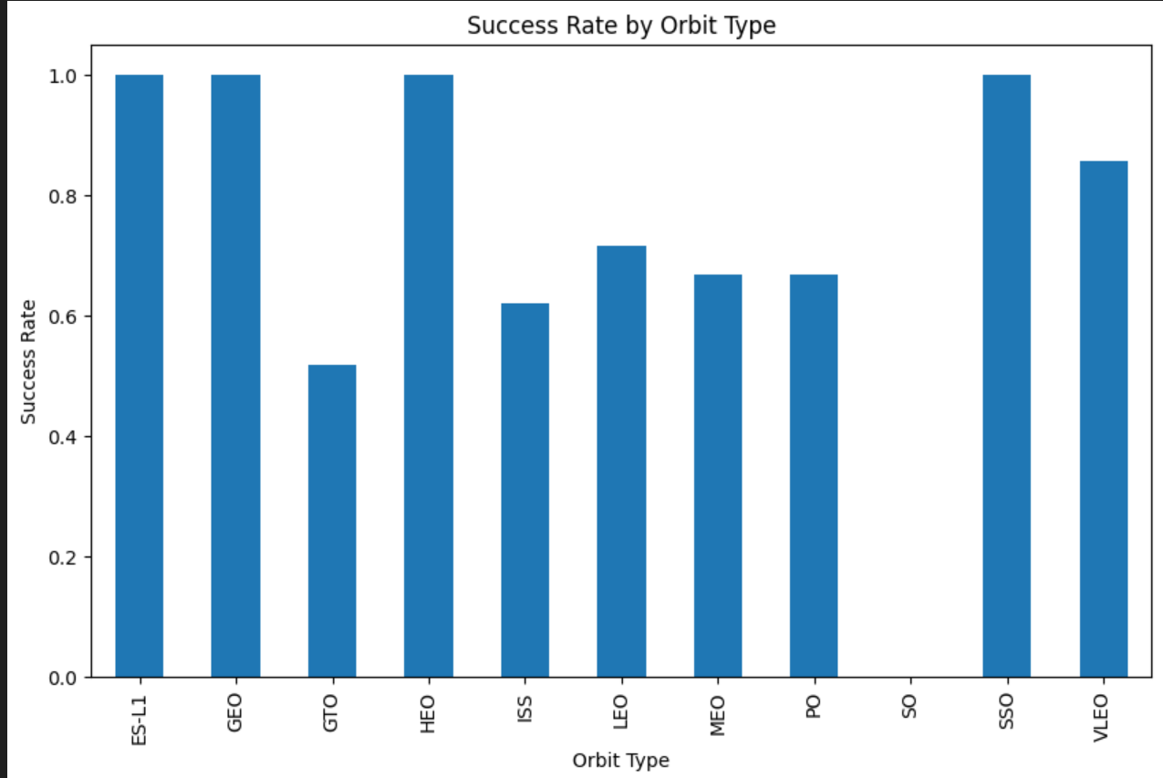
Success Rate vs. Orbit Type
Success Rate by Orbit Type
- LEO and ISS orbits show moderate success rates (~55–60%) due to early mission failures.
- Rare or high-energy orbits (GEO, ES-L1, HEO, VLEO) show perfect success rates (1.0), reflecting fewer launches and successful outcomes.
- Indicates that mission complexity and frequency can affect observed success rates.

Slide 19
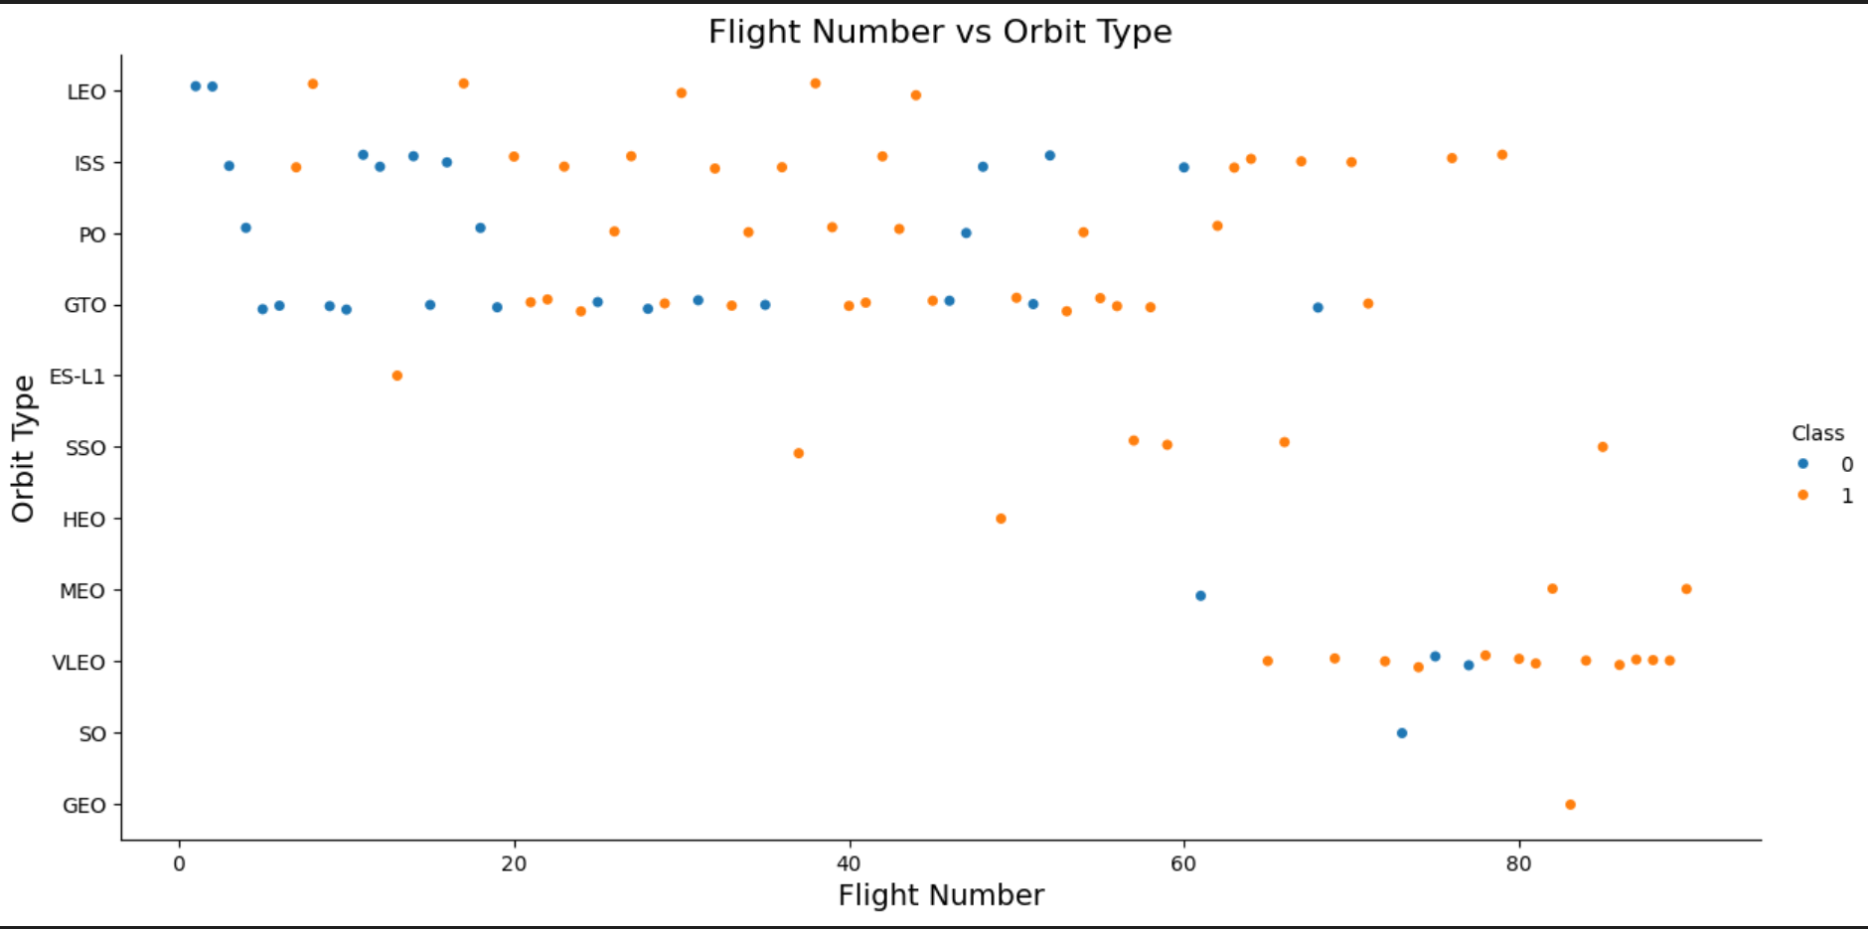
Flight Number vs. Orbit Type
You can observe that in the LEO orbit, success seems to be related to the number of flights. Conversely, in the GTO orbit, there appears to be no relationship between flight number and success.

Slide 20
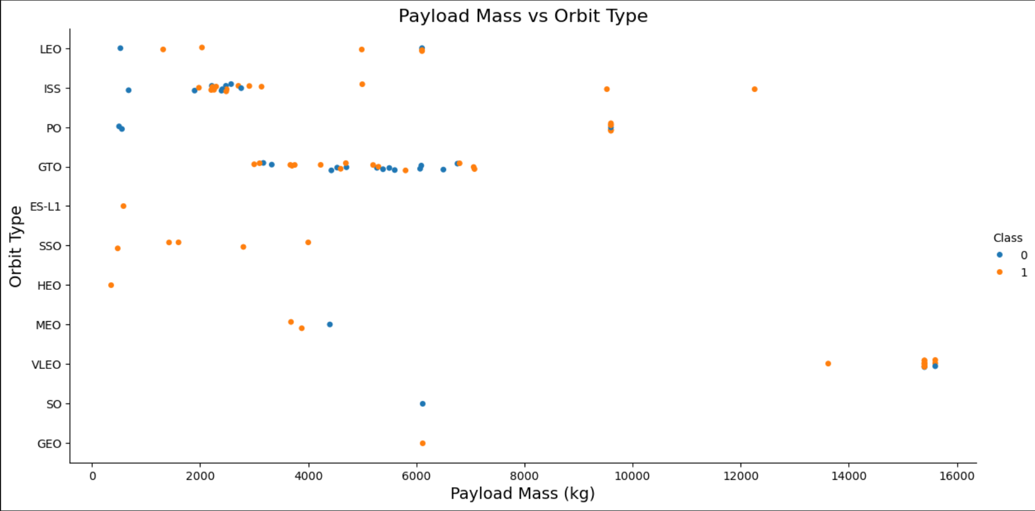
Payload vs. Orbit Type
With heavy payloads the successful landing or positive landing rate are more for Polar,LEO and ISS.
However, for GTO, it's difficult to distinguish between successful and unsuccessful landings as both outcomes are present.

Slide 21
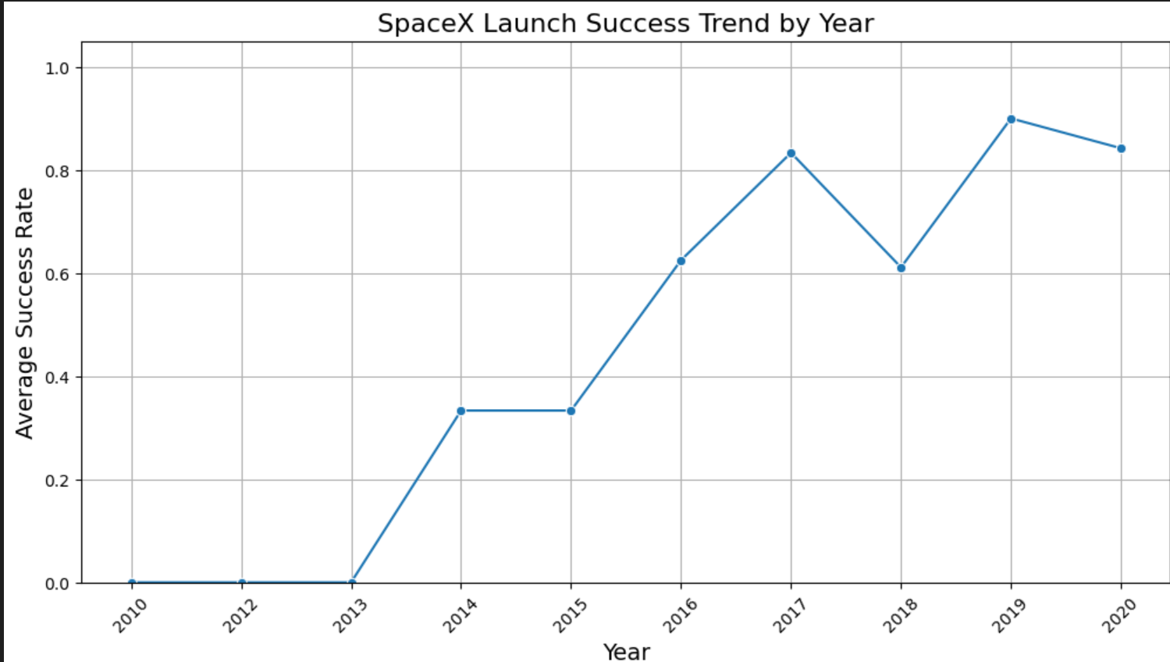
Launch Success Yearly Trend
you can observe that the success rate since 2013 kept increasing till 2020

Slide 22
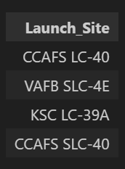
All Launch Site Names
Query: Find unique launch sites.
Result: CCAFS LC-40, CCAFS SLC-40, KSC LC-39A, VAFB SLC-4E
Explanation: Identifying launch sites helps focus analysis on site-specific success patterns and payload performance.

Slide 23
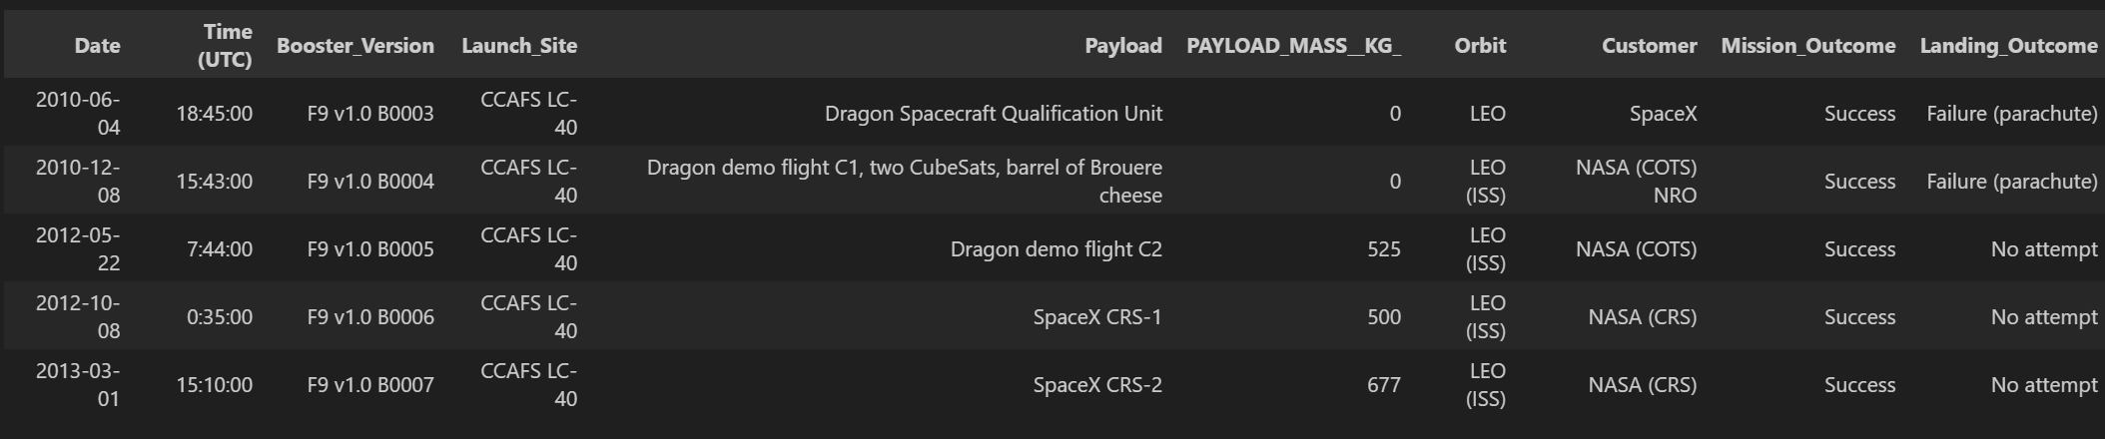
Launch Site Names Begin with 'CCA'
%%sql
SELECT * FROM SPACEXTABLE WHERE "Launch_Site" LIKE 'CCA%’ LIMIT 5;
The query selects the first 5 records where the launch site name starts with “CCA” (Cape Canaveral Air Force Station).
This helps quickly inspect the data for specific launch sites.
Useful for verifying payloads, booster versions, and success/failure status for these sites before deeper analysis.

Slide 24
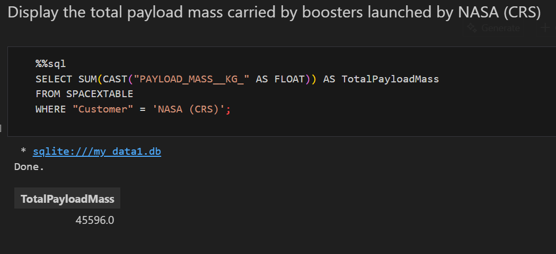
Total Payload Mass
This query calculates the total payload mass carried by all boosters launched for NASA missions.
Helps understand the scale of payloads handled for a specific customer.
Useful for comparing contributions of different customers and evaluating payload distribution across launch sites.

Slide 25
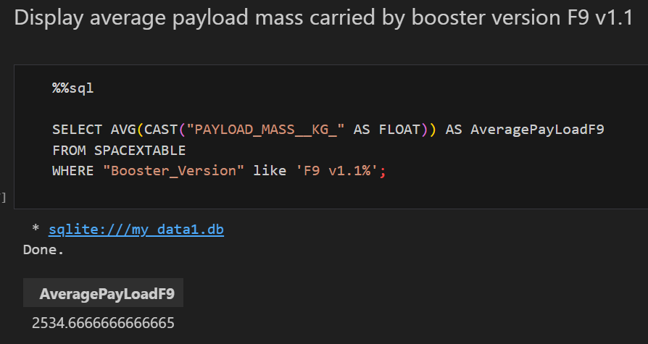
Average Payload Mass by F9 v1.1
This query calculates the average payload mass carried by the F9 v1.1 booster version.
Helps understand the typical payload range handled by this specific booster.
Useful for performance comparison between booster versions and assessing reliability at different payloads.

Slide 26
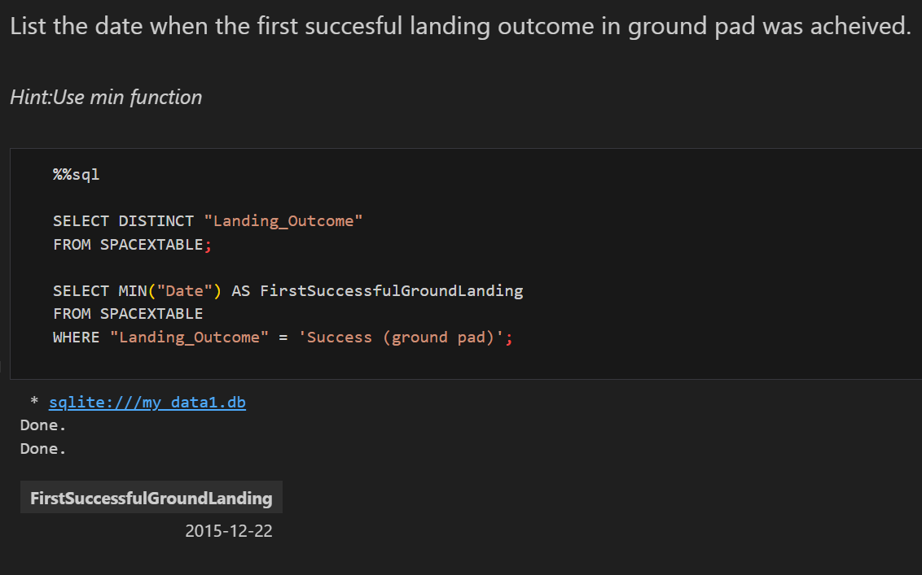
First Successful Ground Landing Date
This query identifies the earliest date when a booster achieved a successful landing on a ground pad.
Helps track SpaceX’s progress in achieving reusable booster technology.
Provides a reference point for analyzing how subsequent launches and landings have improved over time.

Slide 27
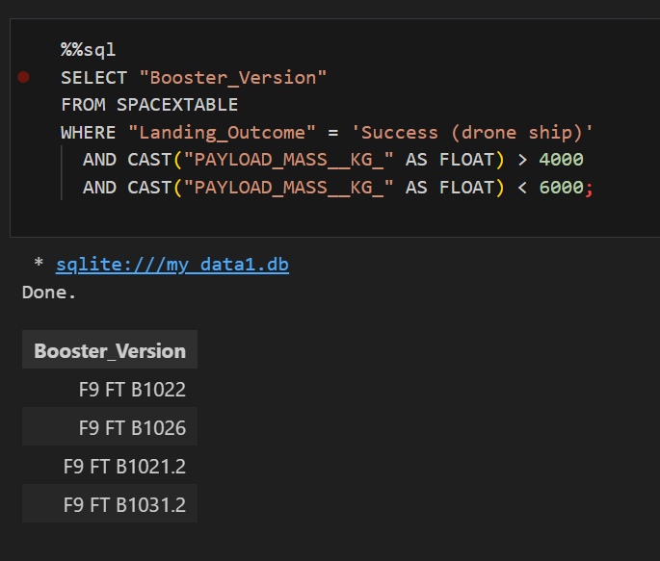
Successful Drone Ship Landing with Payload between 4000 and 6000
This query retrieves the booster names that successfully landed on the drone ship while carrying a moderate payload (4000–6000 kg).
Helps identify which boosters perform reliably under specific payload conditions.
Provides insight into the relationship between payload mass and landing success for operational planning.

Slide 28
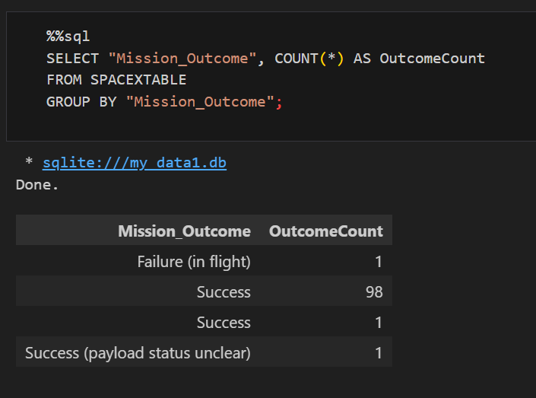
Total Number of Successful and Failure Mission Outcomes
This query calculates the total count of successful and failed missions.
Helps quickly assess the overall success rate of SpaceX launches.
Provides a clear metric for evaluating mission reliability and identifying patterns for further analysis.

Slide 29
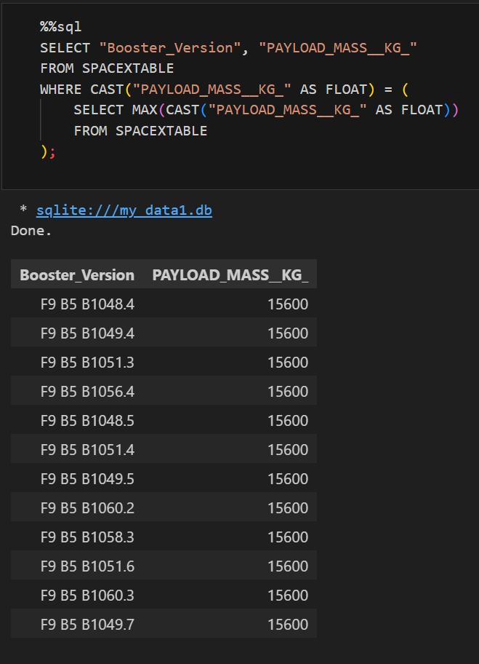
Boosters Carried Maximum Payload
This query identifies the booster(s) that carried the maximum payload mass in a single mission.
Helps highlight the most capable boosters in terms of payload capacity.
Useful for comparing booster performance and planning for future heavy-lift missions.

Slide 30
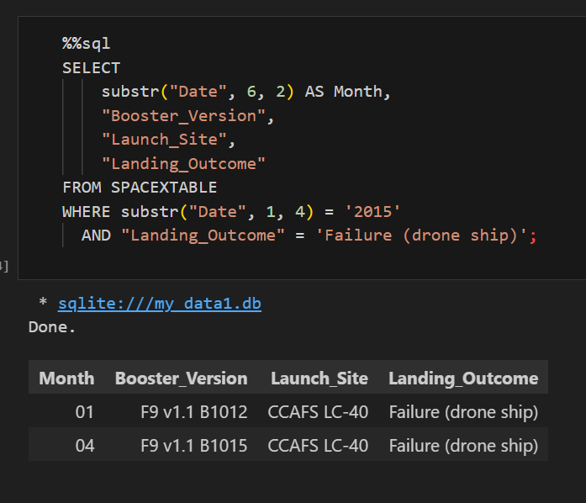
2015 Launch Records
This query lists all failed drone ship landings in 2015, along with their booster versions and launch site names.
Helps analyze early challenges in reusable booster technology.
Provides insight into which booster versions and launch sites experienced difficulties during the initial years of drone ship landings.

Slide 31
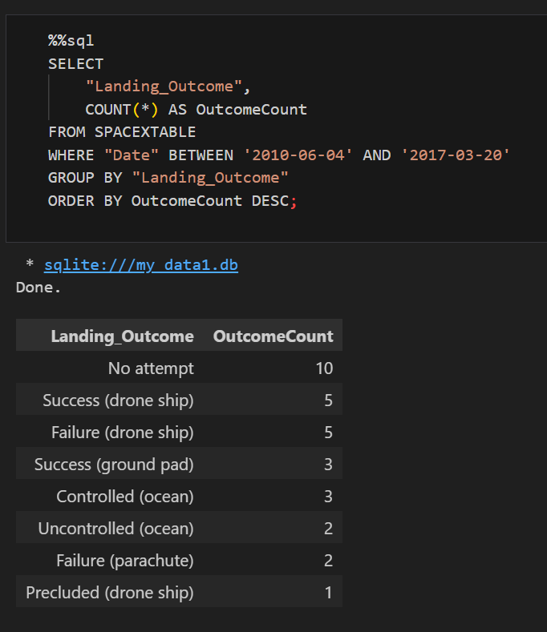
Rank Landing Outcomes Between 2010-06-04 and 2017-03-20
This query ranks the number of landing outcomes (e.g., Failure (drone ship), Success (ground pad)) between June 4, 2010, and March 20, 2017, in descending order.
Helps identify which types of landings were most common during the early years of SpaceX’s booster recovery program.
Provides insight into trends in landing success and failure rates over time, highlighting operational challenges and improvements.

Slide 32

Section 3

Slide 33
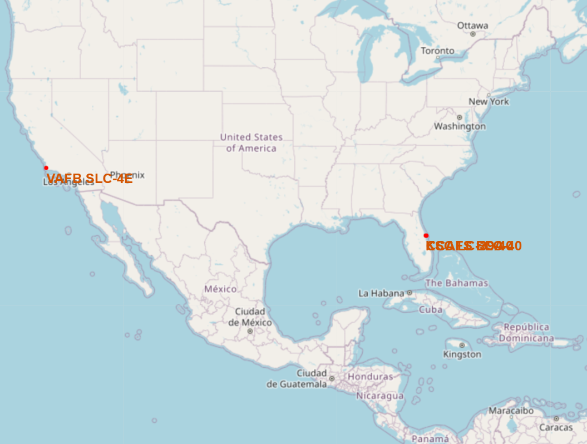
SpaceX Launch Sites: Geographic Distribution
Red circles: Represent each SpaceX launch site with a radius of 1000 meters.
Yellow fill: Highlights the location clearly on the map.
Popup labels: Display the name of the launch site when clicked.
Text markers: Show launch site names directly on the map for easy identification.
Findings:
All four main launch sites are clearly visible: CCAFS LC-40, CCAFS SLC-40, KSC LC-39A, VAFB SLC-4E.
Sites are concentrated in the United States, with two in Florida and two on the west coast.
Provides a visual overview of launch site distribution for spatial analysis and planning.

Slide 34
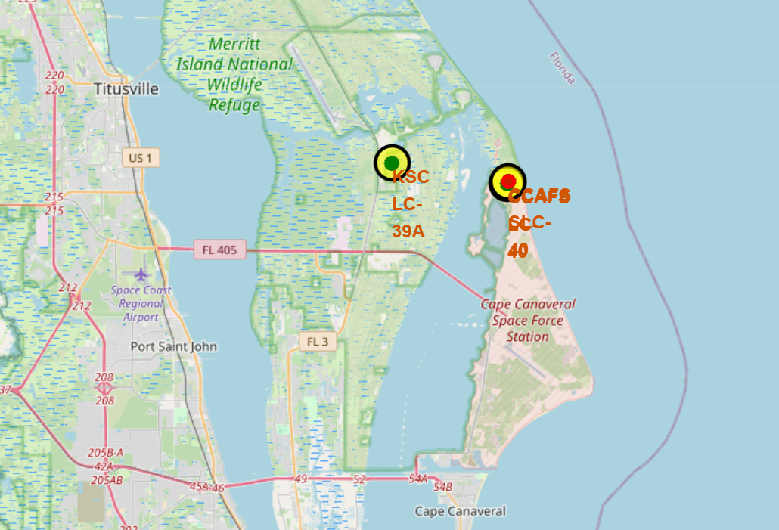
SpaceX Launch Outcomes: Success vs. Failure
Key Elements:
Red circles: Represent failed launches (Class 0).
Green circles: Represent successful launches (Class 1).
Yellow-filled circles with black borders: Indicate the launch site locations.
Text markers: Show the name of each launch site near its circle.
Findings:
Most launches from KSC LC-39A and CCAFS LC-40/SLC-40 were successful (green markers).
Failures (red markers) are scattered and less frequent, showing improvement in launch reliability over time.
The map visually correlates launch outcomes with geographic location, helping identify patterns and trends for specific launch sites.

Slide 35
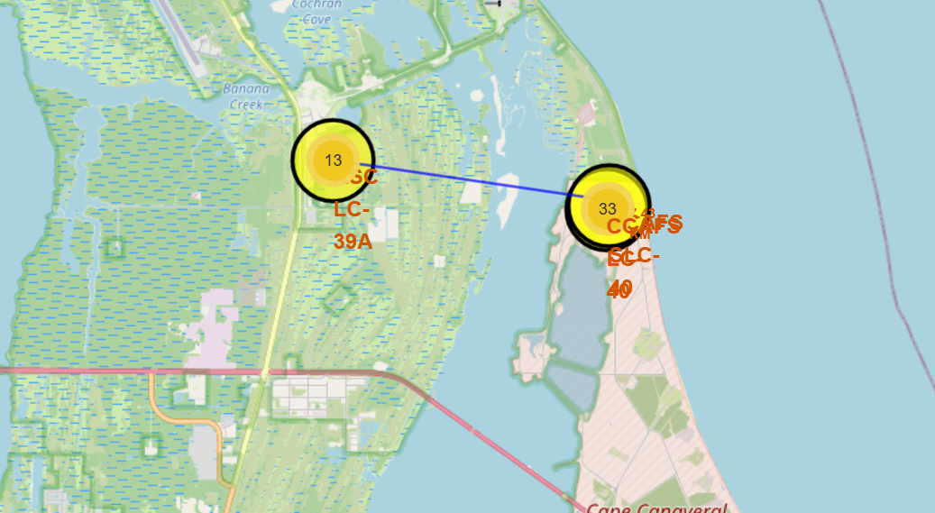
Proximity of Launch Site to Coastline
Key Elements:
Blue line: Represents the direct distance between the launch site and the nearest coastline.
Launch site marker: Shows the exact location of the selected launch site.
Coastline marker: Indicates the reference point on the coast used for distance measurement.
FINDINGS :
Visualizes the geographic proximity of the launch site to the coastline, which is important for rocket recovery and safety planning.
Helps assess potential impacts of nearby transport infrastructure (railways, highways) and landing zones.
Provides a clear spatial understanding of site logistics, safety, and operational planning considerations.

Slide 36

Section 4

Slide 37
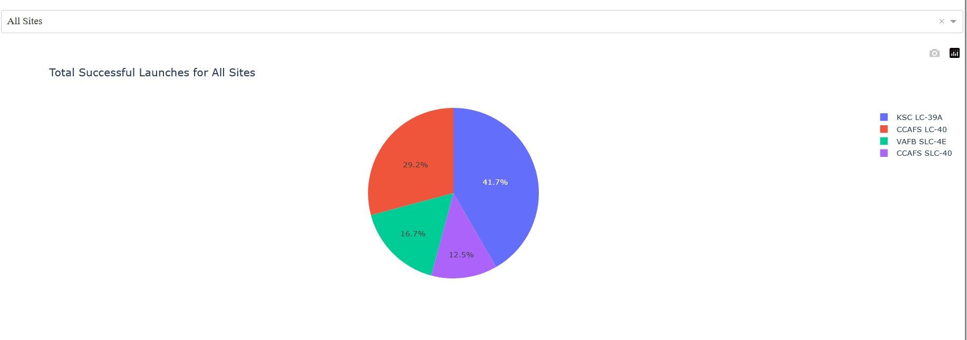
KSC LC-39A and CCAFS LC-40/SLC-40 have the highest number of successful launches.
Provides a quick visual comparison of launch performance across sites.
Highlights which launch sites contributed most to SpaceX’s overall mission success.
Launch Success Counts by Site (Pie Chart)
KSC LC-39A and CCAFS LC-40/SLC-40 have the highest number of successful launches.
Provides a quick visual comparison of launch performance across sites.
Highlights which launch sites contributed most to SpaceX’s overall mission success.

Slide 38
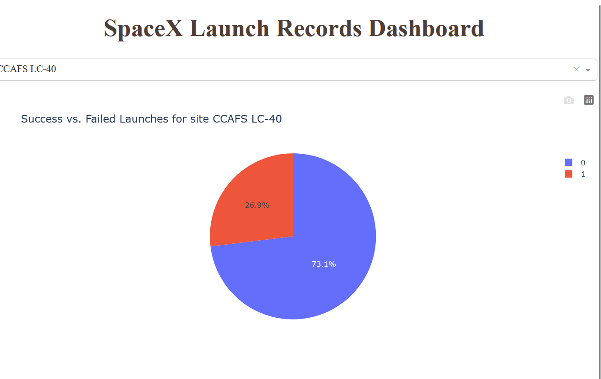
Launch Success Ratio for CCAFS LC-40 (Pie Chart)
Most launches are successful (73.1%), demonstrating the site’s high reliability.
Failures are limited (26.9%), helping identify risk factors for improvement.
Visualizes the success-to-failure ratio clearly, supporting analysis of site performance and predictive modeling

Slide 39
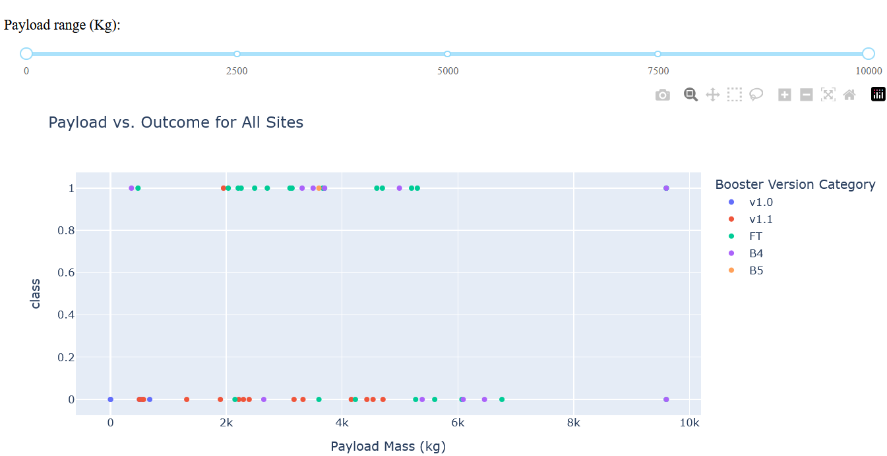
Payload vs. Launch Outcome Scatter Plot (All Sites)
Moderate payload ranges (~4000–6000 kg) show the highest success rates.
Certain booster versions (e.g., F9 v1.1) perform more reliably with medium payloads.
Very high or very low payloads tend to have a higher proportion of failures.
Interactive visualization helps identify optimal payload ranges and assess booster performance across sites.

Slide 40

Section 5

Slide 41
Classification Accuracy
All tested classifiers achieved the same accuracy of 83.3% on the validation/test dataset.
Indicates that the dataset may be well-balanced or not very complex, so multiple models perform similarly.
Suggests that other factors, like model interpretability or training time, could be used to select a preferred model.

Slide 42
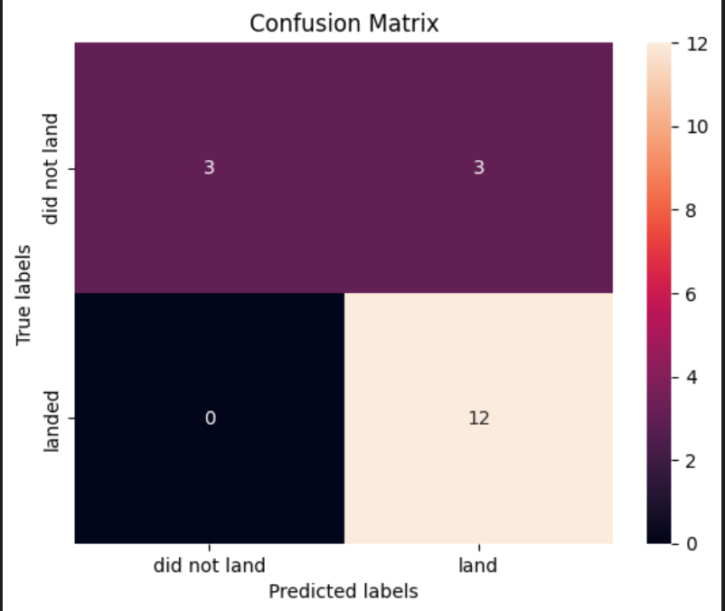
Confusion Matrix
True Positives (TP): 12 launches correctly predicted as successes
True Negatives (TN): 3 launches correctly predicted as failures
False Positives (FP): 3 launches incorrectly predicted as successes
False Negatives (FN): 0 launches incorrectly predicted as failures
The matrix shows that the Sigmoid SVM accurately predicts most launches, with a few failures misclassified as successes.
Supports the overall 83.3% classification accuracy.

Slide 43
Conclusions
SpaceX launch data shows that most launches are successful, with a success rate of ~83%.
Launch sites such as CCAFS LC-40 and KSC LC-39A consistently perform better, highlighting site reliability differences.
Exploratory Data Analysis revealed that moderate payload ranges (4000–6000 kg) have the highest launch success rate, and booster version F9 v1.1 performs reliably in this range.
Interactive visualizations (Folium maps and Plotly Dash) help identify geographic patterns, landing outcomes, and site-specific trends, making operational planning clearer.
Predictive modeling using classification models (SVM) achieved 83.3% accuracy, confirming that multiple classifiers can effectively predict launch outcomes.
The project demonstrates the importance of data wrangling, EDA, SQL queries, and visualization for extracting actionable insights from real-world aerospace datasets.

Slide 44
Appendix
Python Libraries Used
Data Manipulation: pandas, numpy
Visualizations: matplotlib, seaborn, plotly
Interactive Maps: folium
Machine Learning: scikit-learn
Database / SQL: sqlite3

Slide 45


